Slide 1
Final Project: Team Javabean
Members:
Chuanqi Zhang, Devina Jaiswal, Yuqi Zhang

Slide 2
Problem Description
There are too many dental clinics and insurance companies around
The information is separated
One dentist can’t review a patient’s treatment history from another clinic
Insurance companies have on access to customer’s oral health information
Customers with better oral health got no reward when buying insurance

Slide 3
Solution
A system that connects the three parties:
Patients / Customer
Dental Clinic
Front Desk
Dentist
Manager
Insurance Companies
Customer Representative
Policy Manager

Slide 4
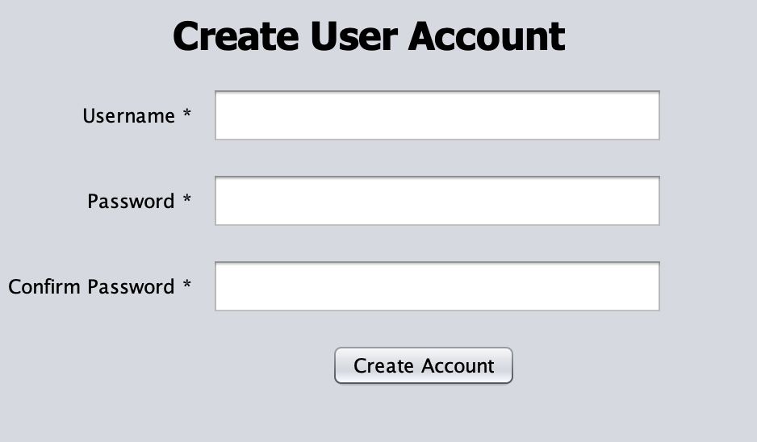
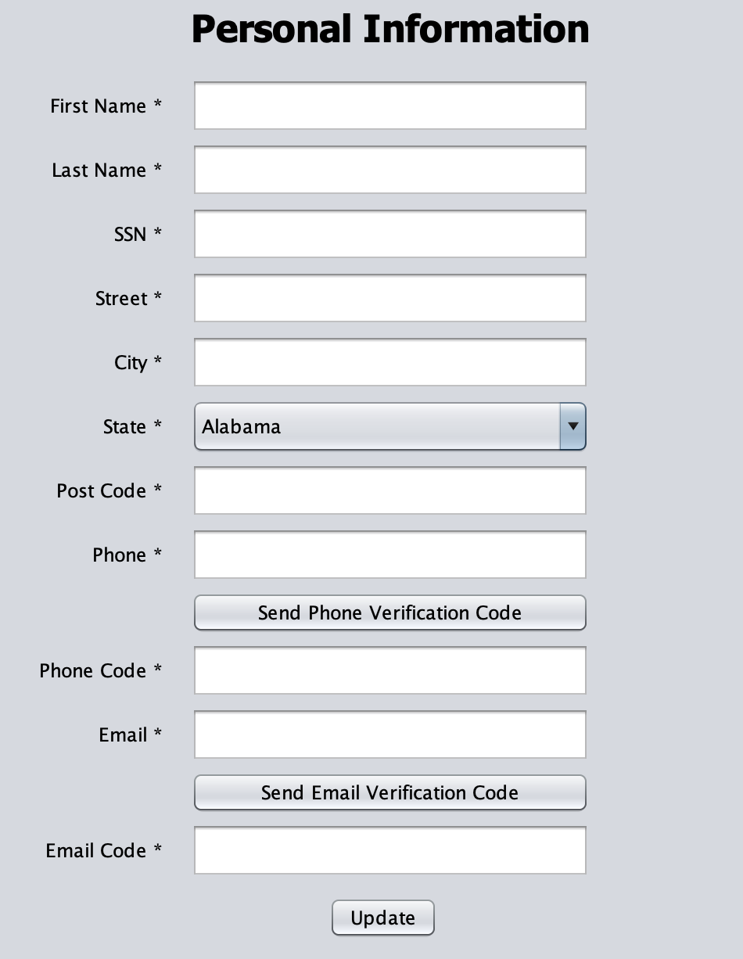
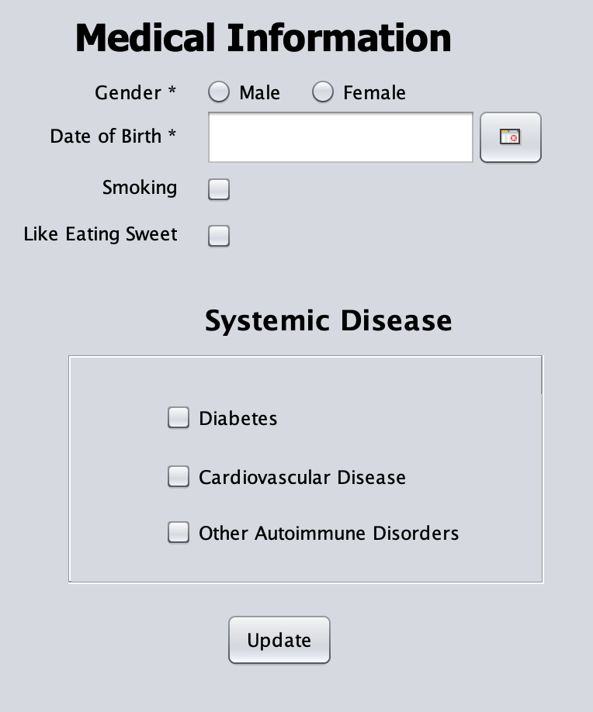
Use Cases - Patient
Sign up

Slide 5
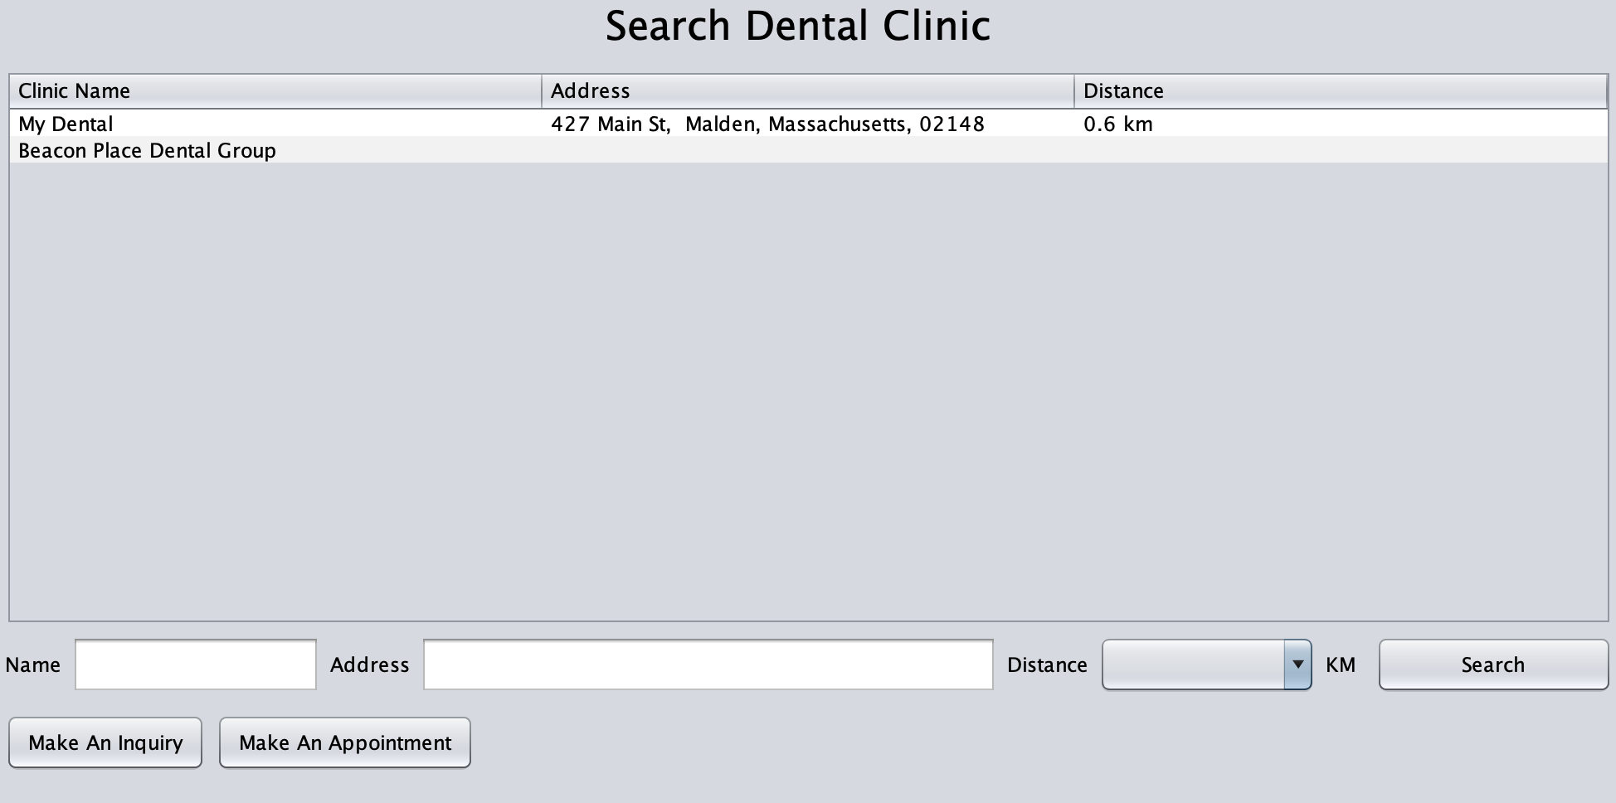
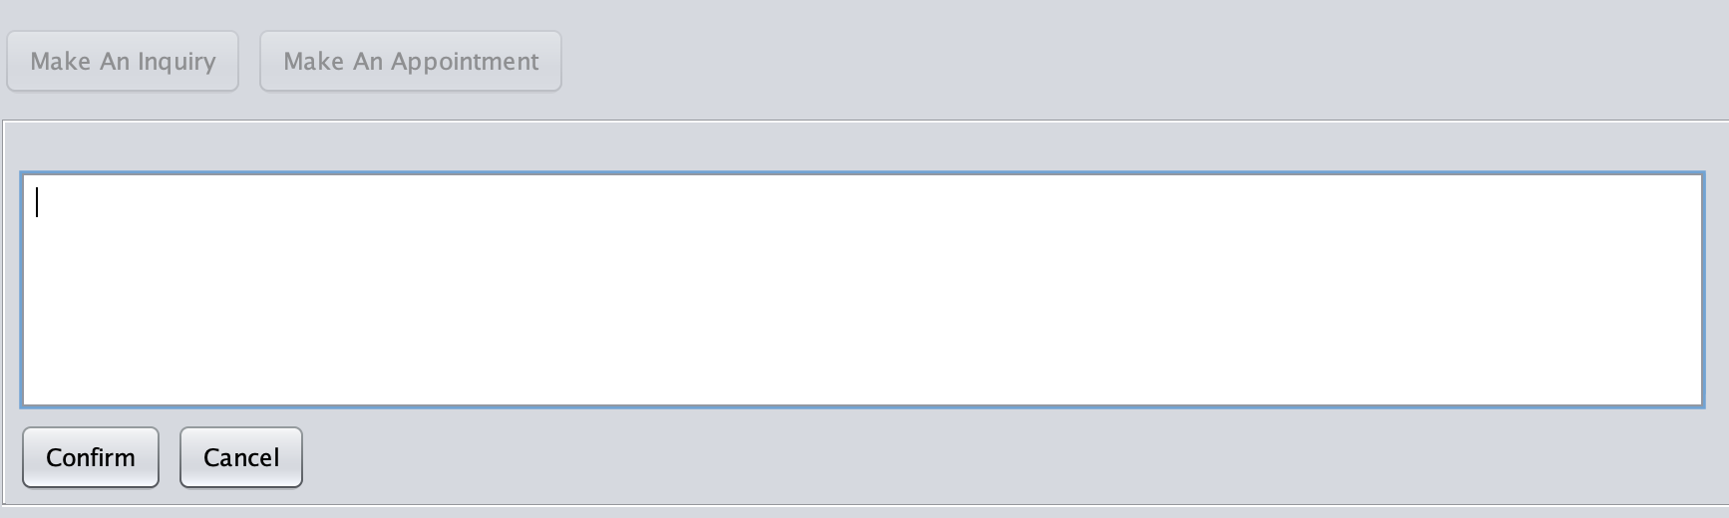
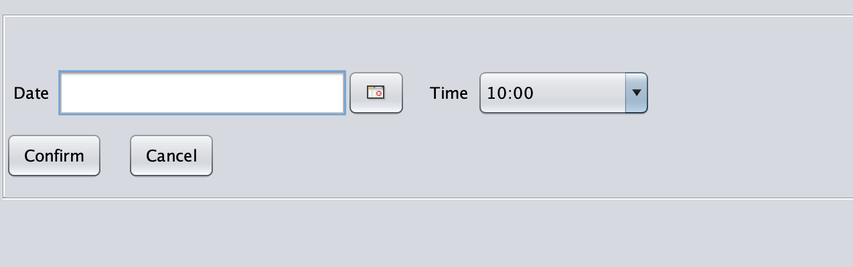
Use Cases - Patient
Search Clinics near your place
make inquiries directly to the clinics
Make appointment

Slide 6
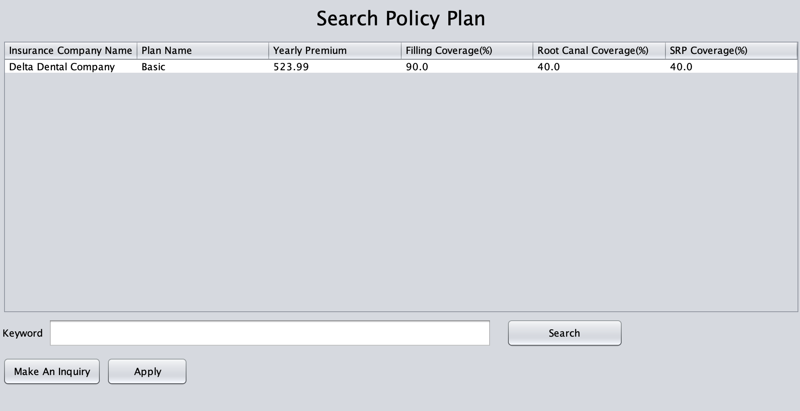
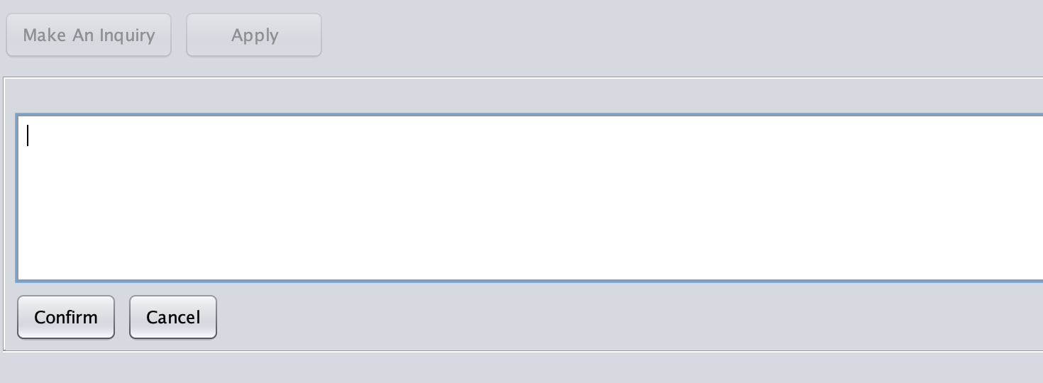
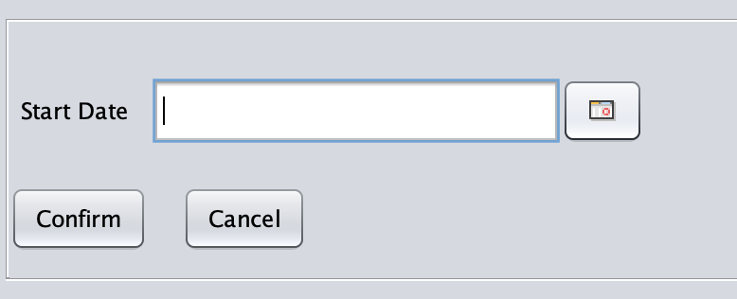
Use Cases - Patient
Search for insurance plans and make inquiries to the insurance companies
Apply for insurance policy

Slide 7
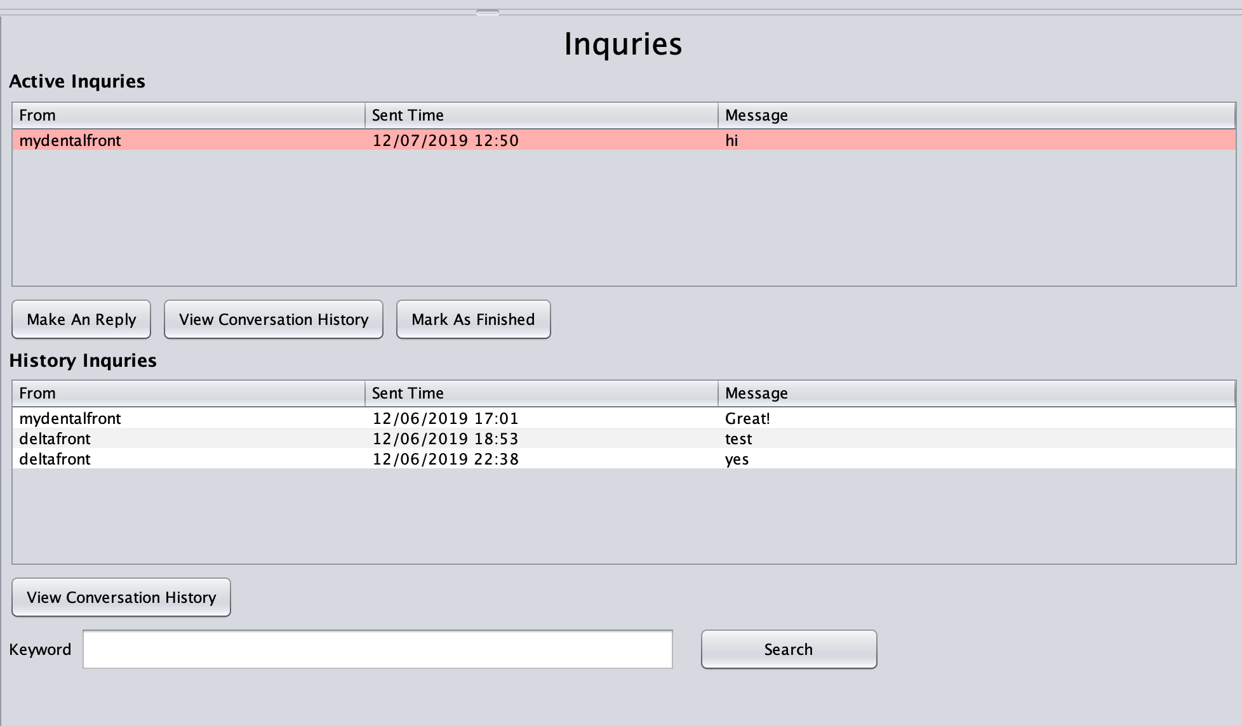
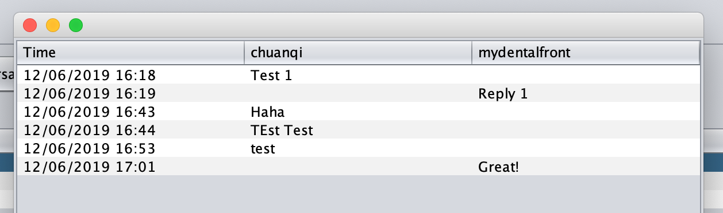
Use Cases - Patient
Manage all the inquiries in one place, inquiries need reply are marked red
View conversation history

Slide 8
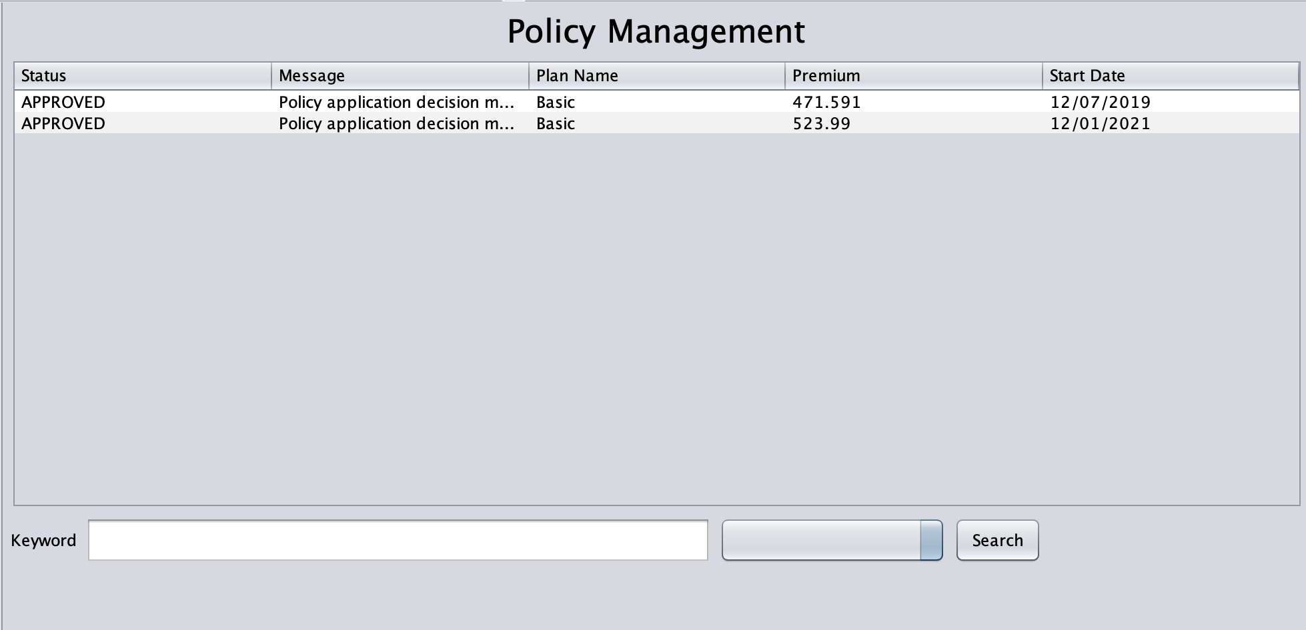
Use Cases - Patient
Manage all the policies

Slide 9
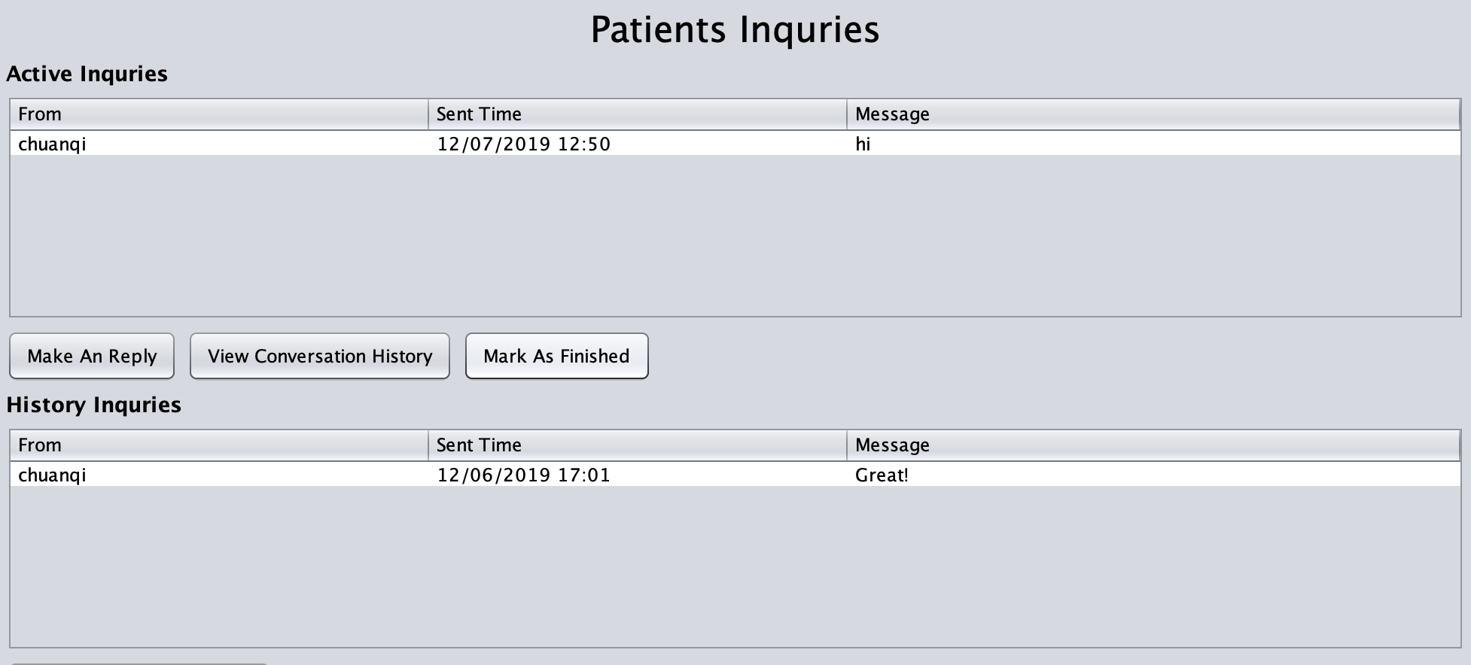
Use Cases – Dental Clinic – Front Desk
Manage Patients’ inquiries

Slide 10
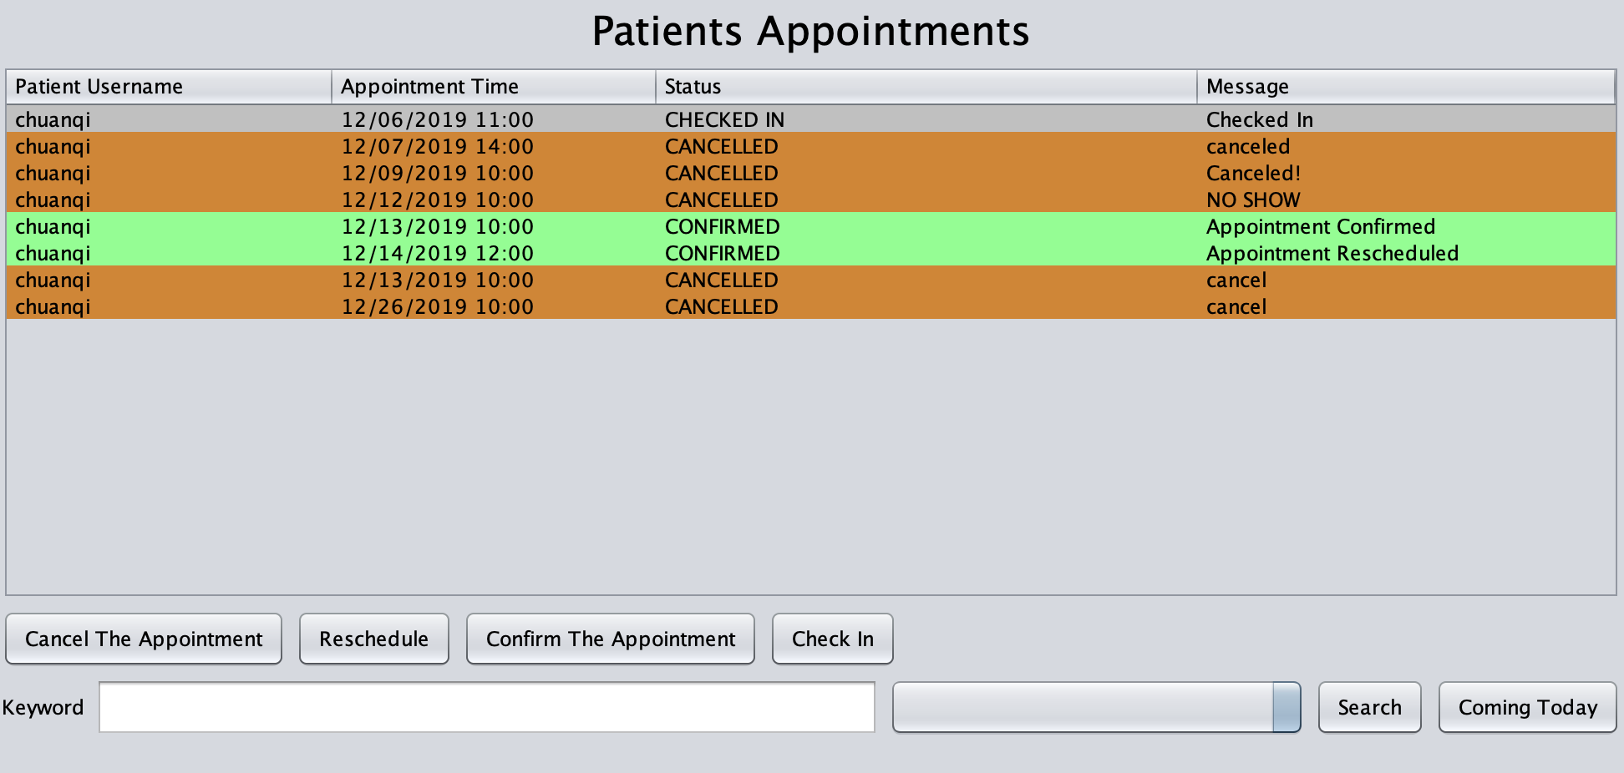
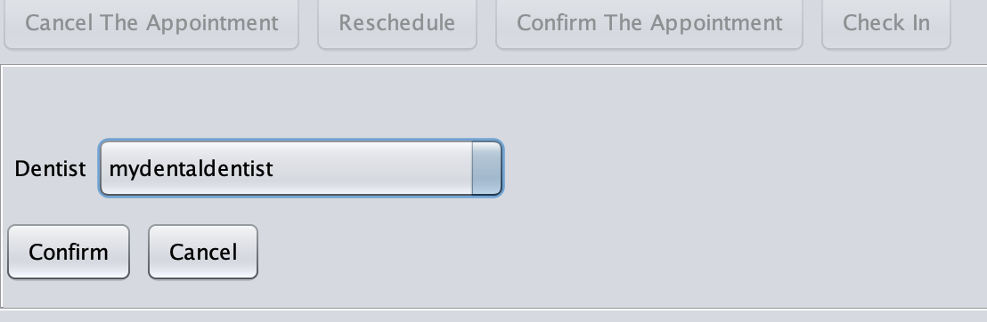
Use Cases – Dental Clinic – Front Desk
Manage patients’ appointments
You can confirm, reschedule, cancel or the appointments
Also, you can check in the patient when he coms

Slide 11
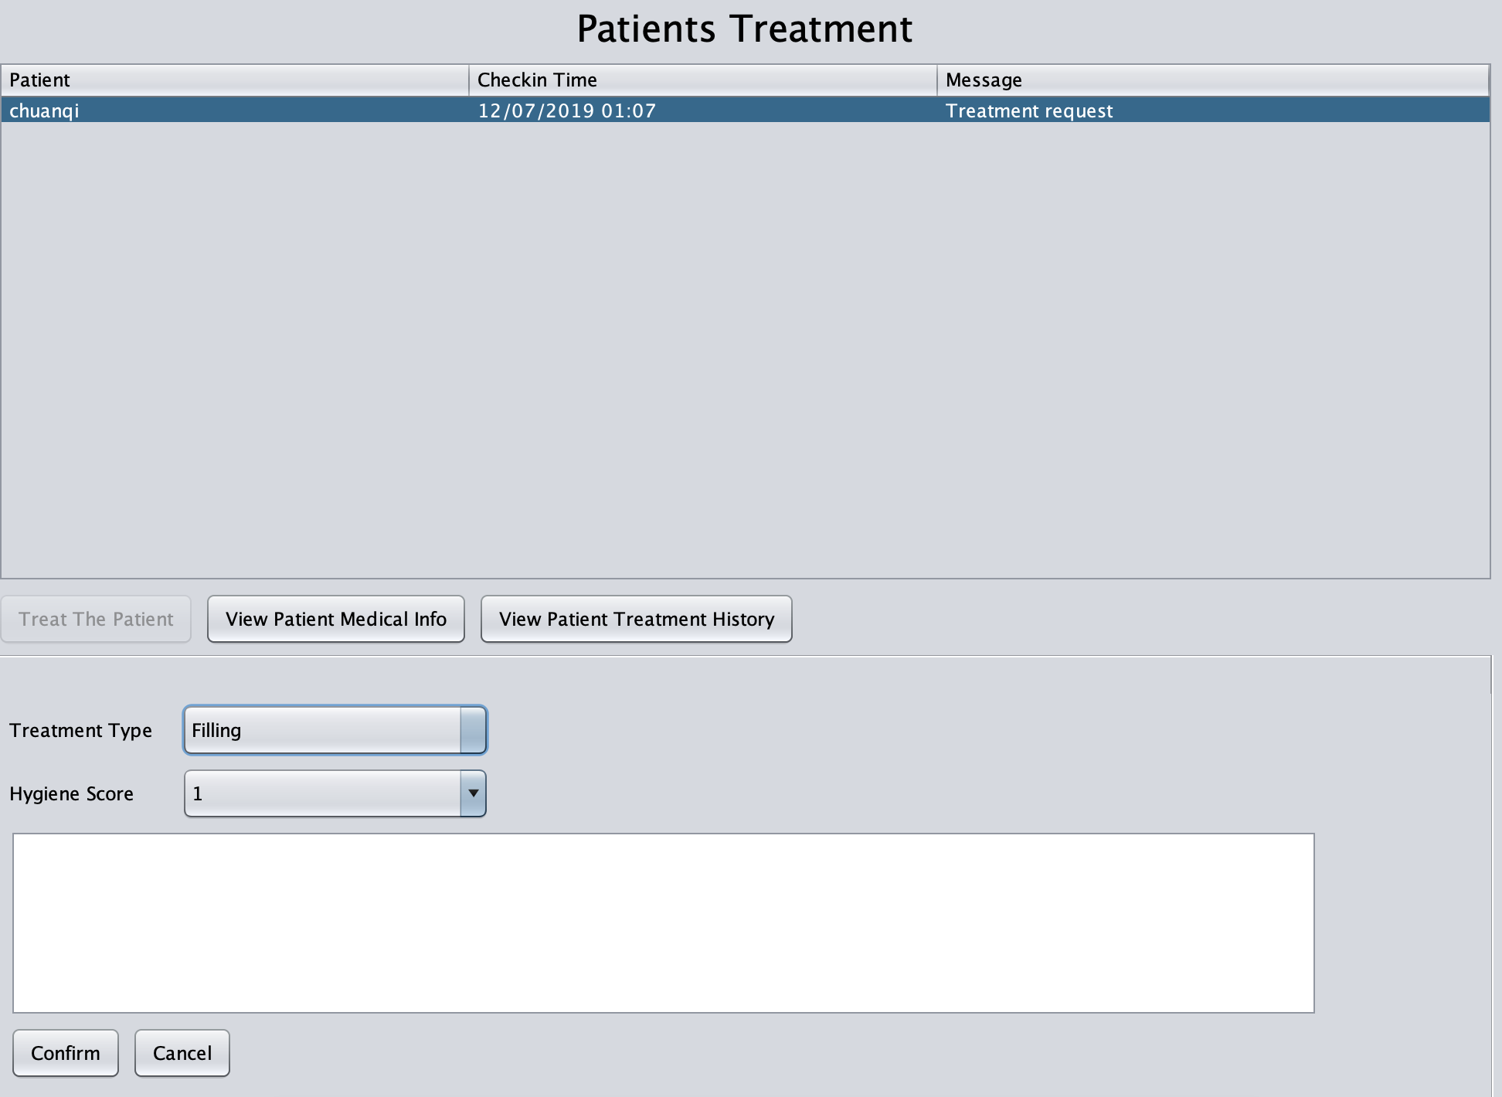
Use Cases – Dental Clinic – Dentist
Treat the checked in patients

Slide 12
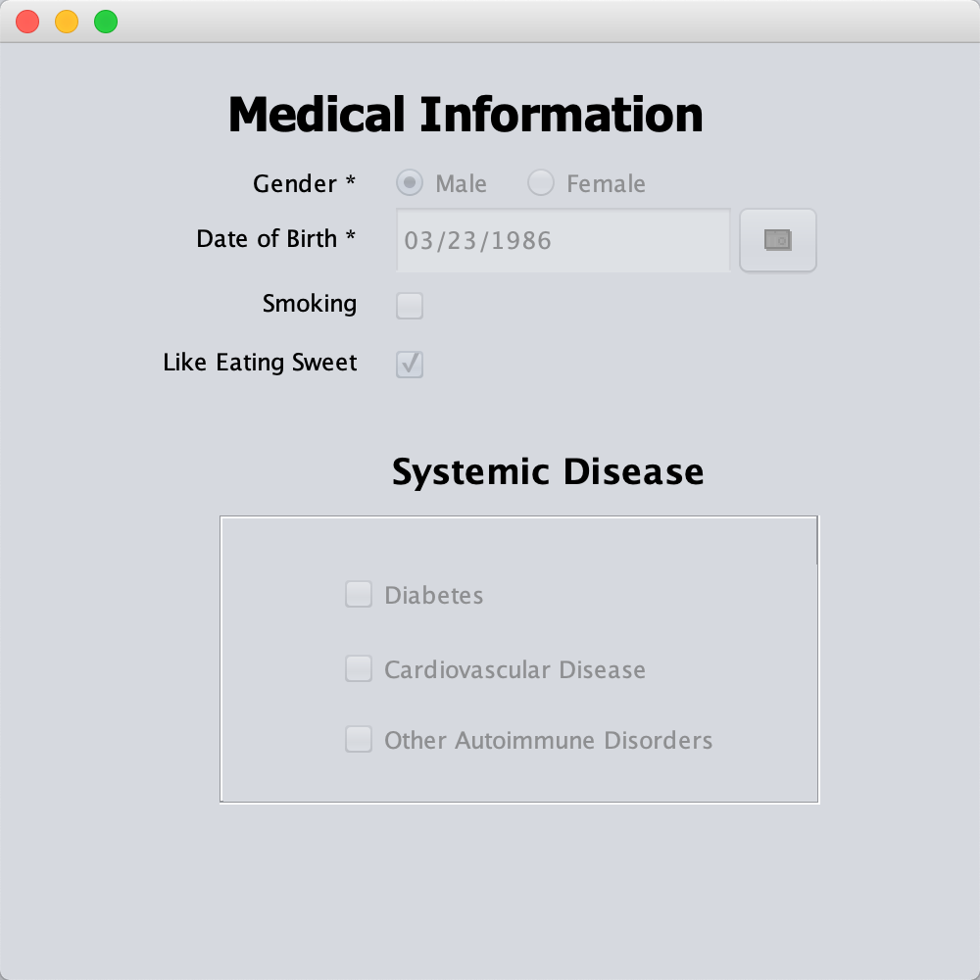
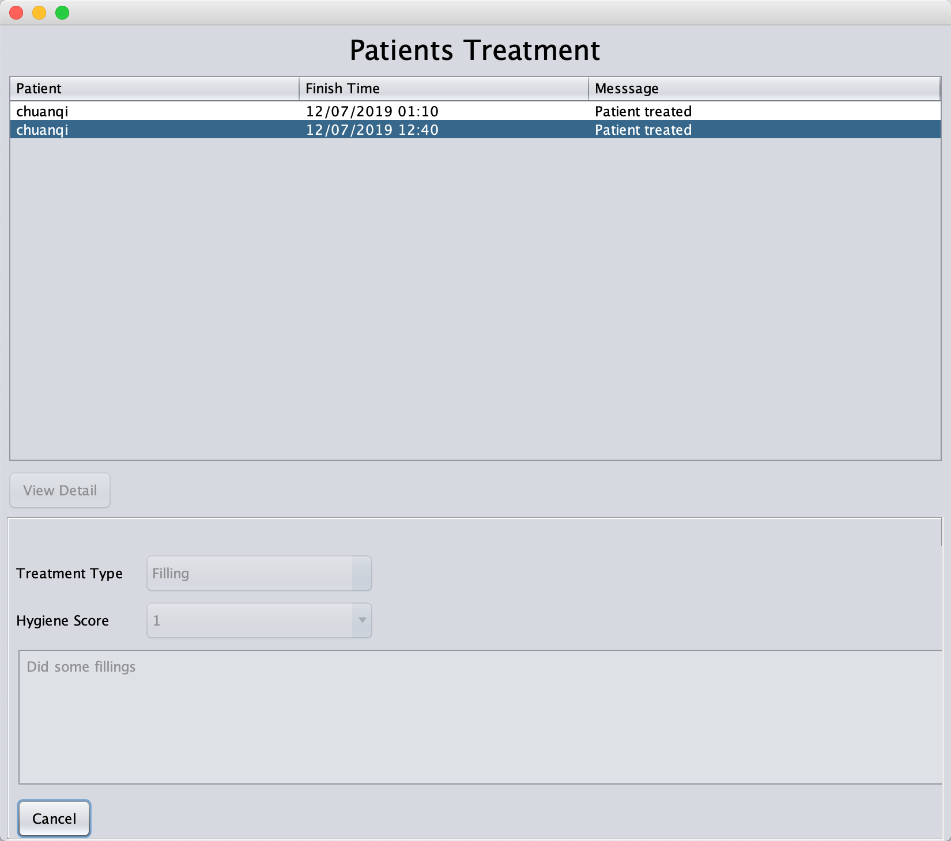
Use Cases – Dental Clinic – Dentist
View patients’ medical information and all treatment history

Slide 13
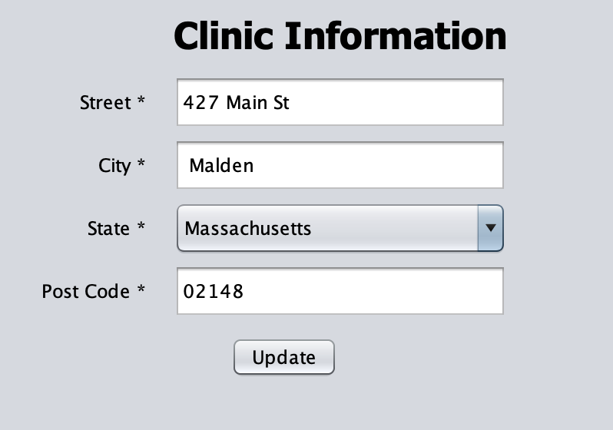
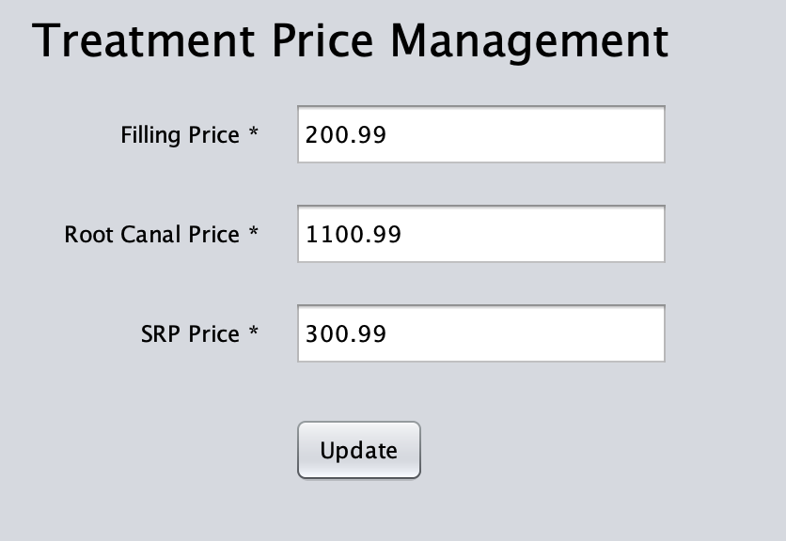
Use Cases – Dental Clinic – Manager
Set the clinic information and treatment fees

Slide 14
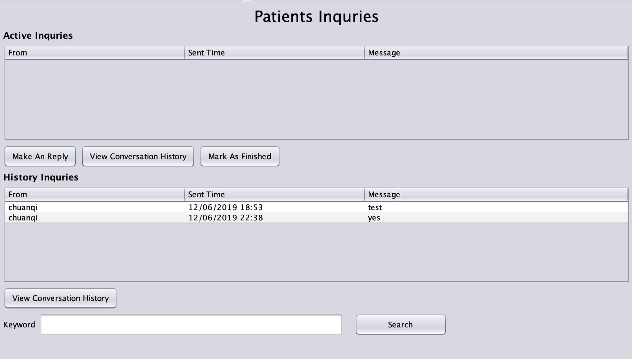
Insurance – Customer Service
Manage Patients’ inquiries

Slide 15
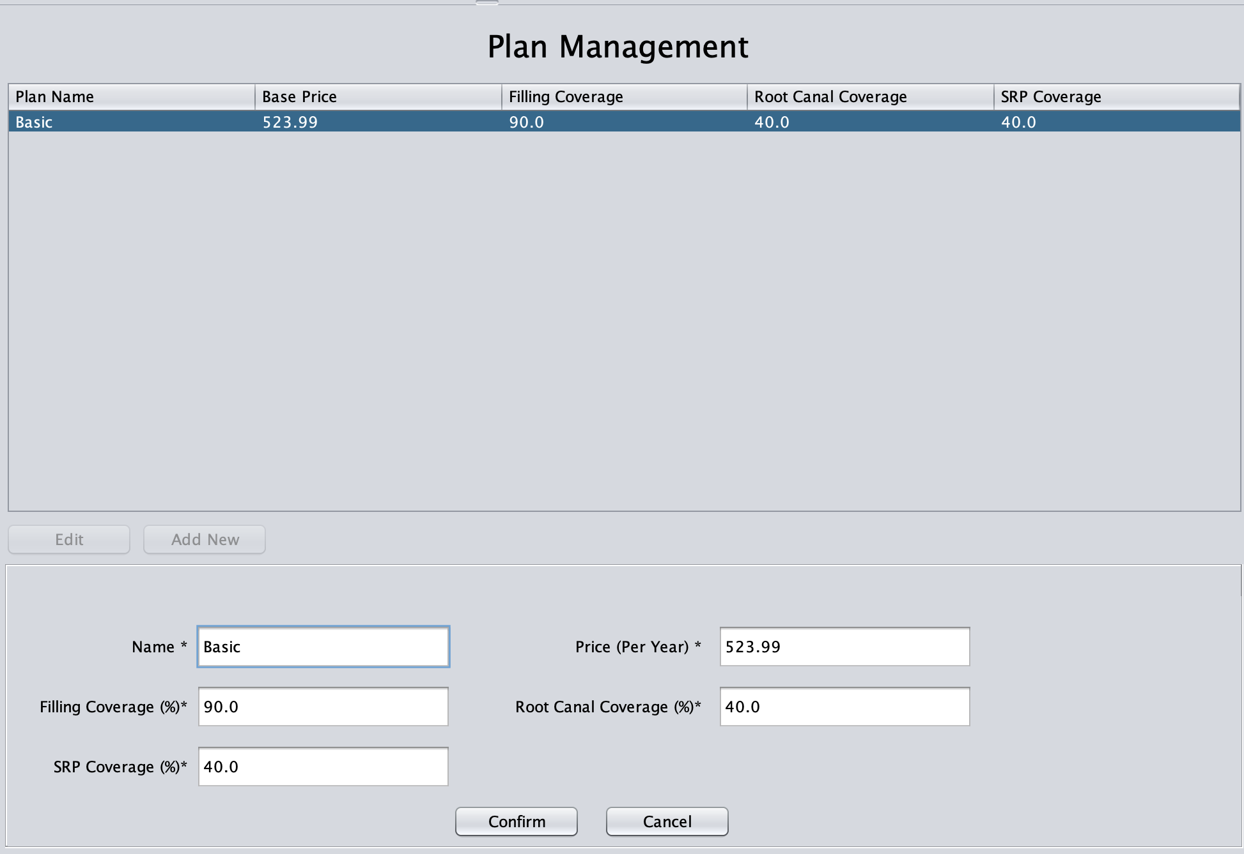
Insurance – Policy Manager
Manage insurance plans

Slide 16
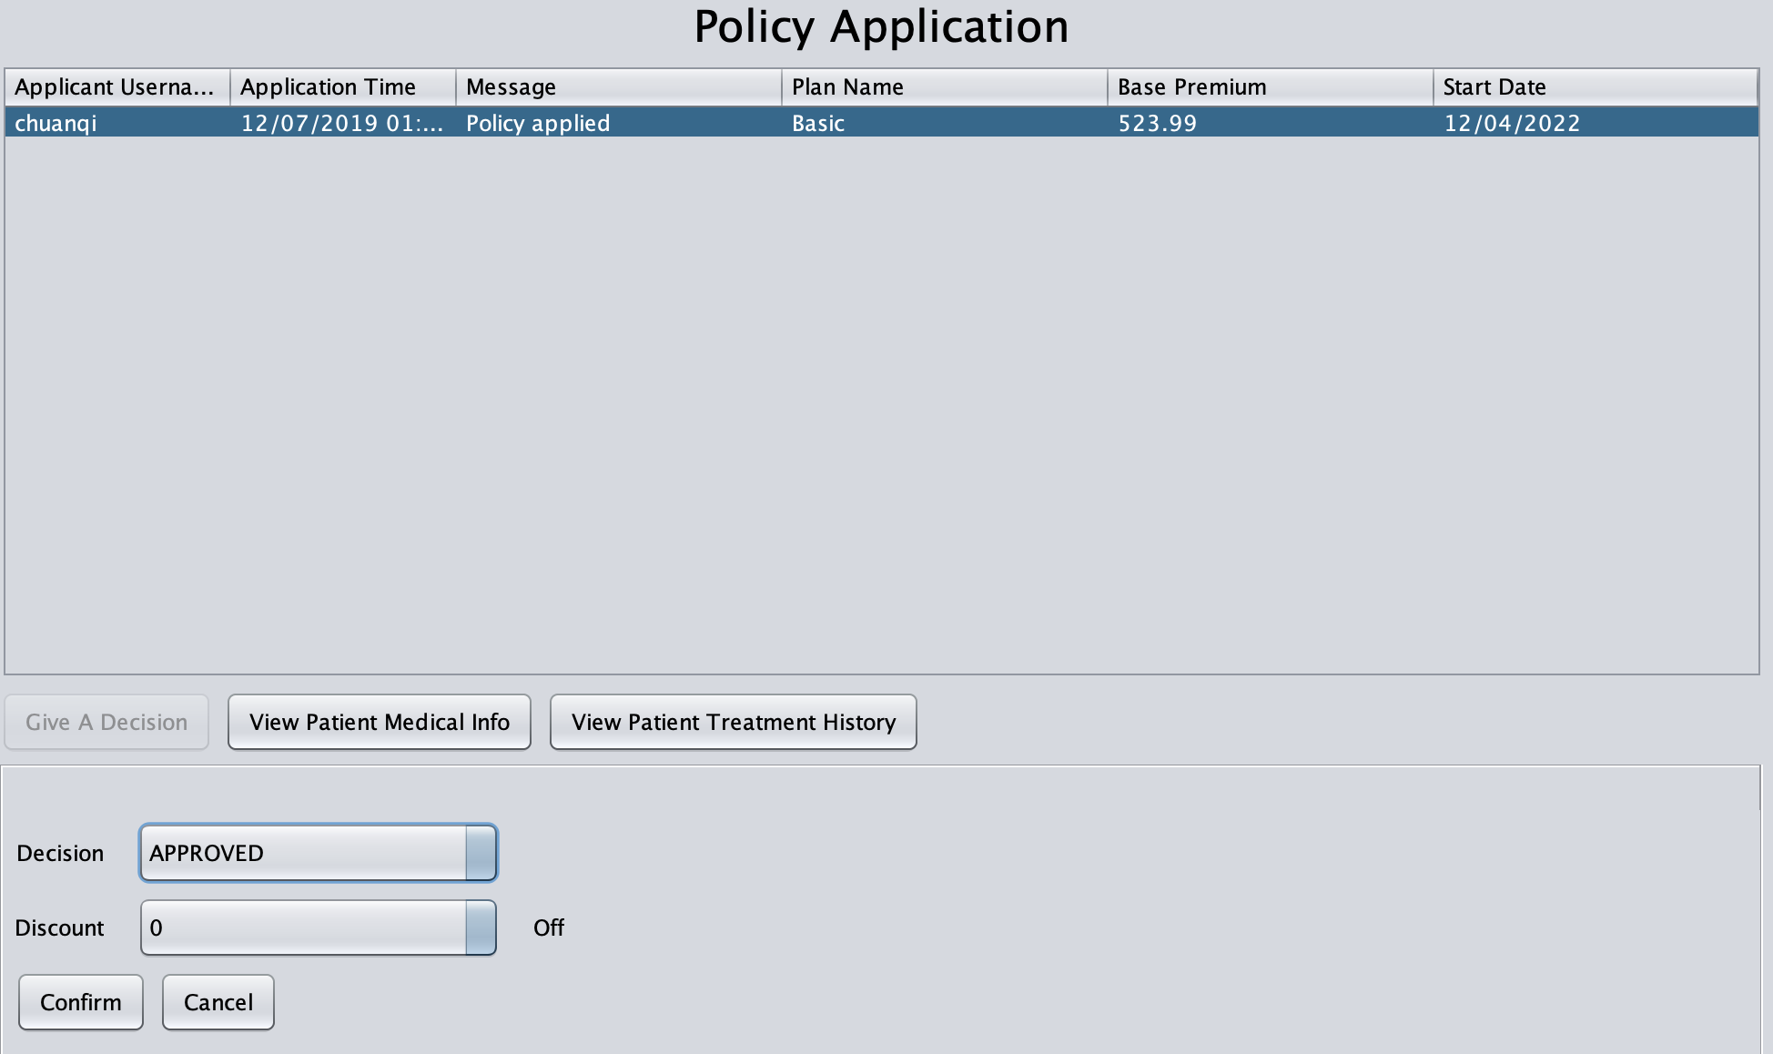
Insurance – Policy Manager
Approve or reject a patients’ policy application, can give a discount
Can also view applicants’ medical information and all treatment history

Slide 17
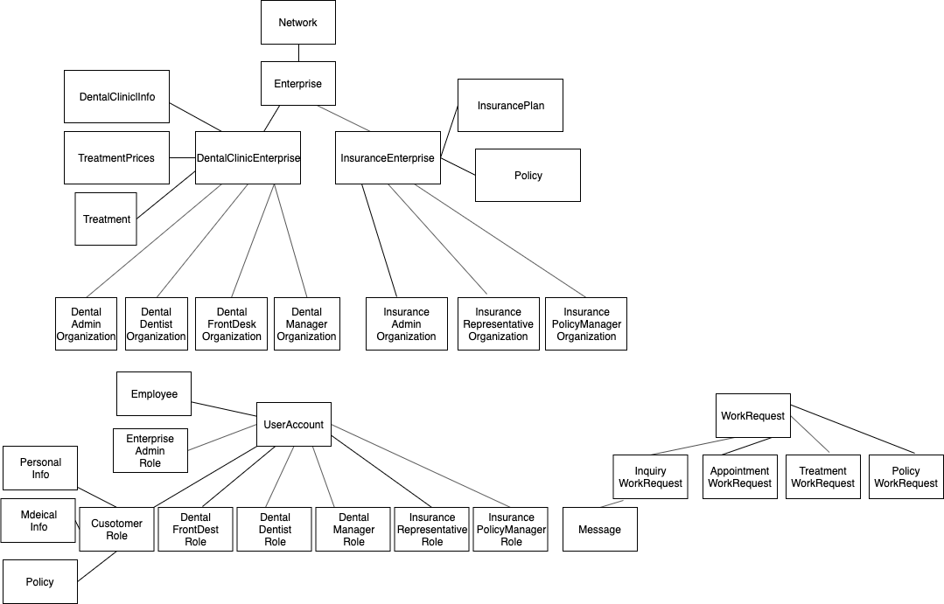
Design

Slide 18
Thanks!

